Slide 1
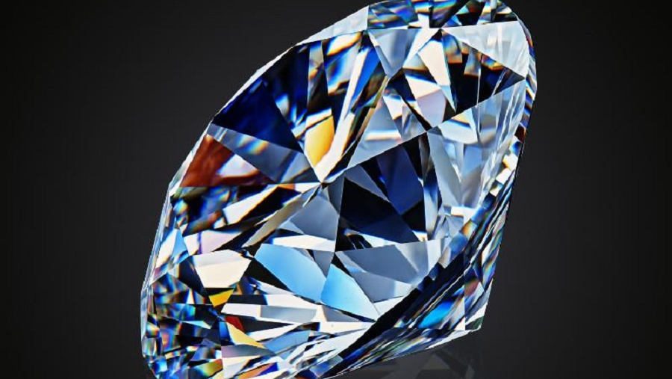
Diamonds Project Presentation
By Mohammad Habash and Dawood Abuswai

Slide 2
Introduction
Our project is about estimating diamonds prices by building machine learning model that can predict the prices according to their features.
You can find the dataset here .

Slide 3
framing the problem
our model is under the following description :
1-Supervised: we have data about the diamonds including their prices -labels-
2- regression: we want to predict numerical continuous data
3- batch learning: all the training will be done offline

Slide 4
insights about the data
we have 11 attribute -including the price -:
-price: price in US dollar
-carat: weight of the diamond
-cut: quality of the cut (Fair, Good, Very Good, Premium, Ideal)
-color: diamond colour, from J (worst) to D (best)
-clarity: a measurement of how clear the diamond is (I1 (worst), SI2, SI1, VS2, VS1, VVS2, VVS1, IF (best))
-x: length in mm
-y:width in mm
-z: depth in mm
-depth: total depth percentage = z / mean(x, y) = 2 * z / (x + y) (43--79)
-table: width of top of diamond relative to widest point

Slide 5
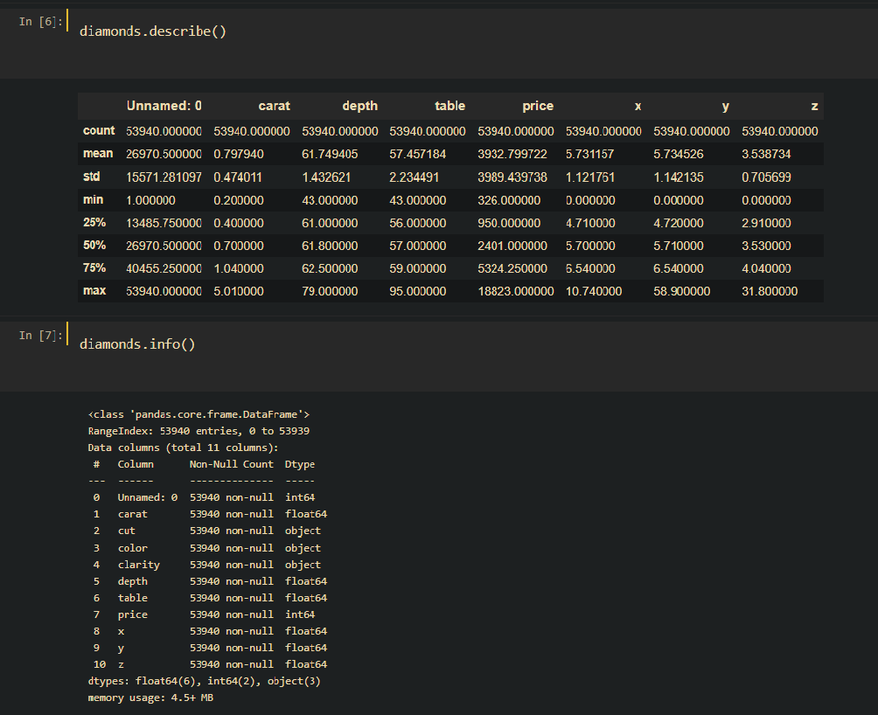
a quick peek at the data
1- if we look at the data we can see that there are some zero’s in the minimum column
2- we can also see that we have some non-numerical data -3 attributes-
3- we don’t have null data
4- Unnamed attribute is just un index

Slide 6
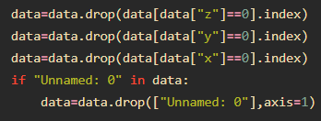
So …. what we are going to do ?
First: we will deal with the zero values by deleting them, since there is not that much 0.
Second: we will drop the unnamed attribute because it is useless.
**We will deal with the non-numerical data later.

Slide 7
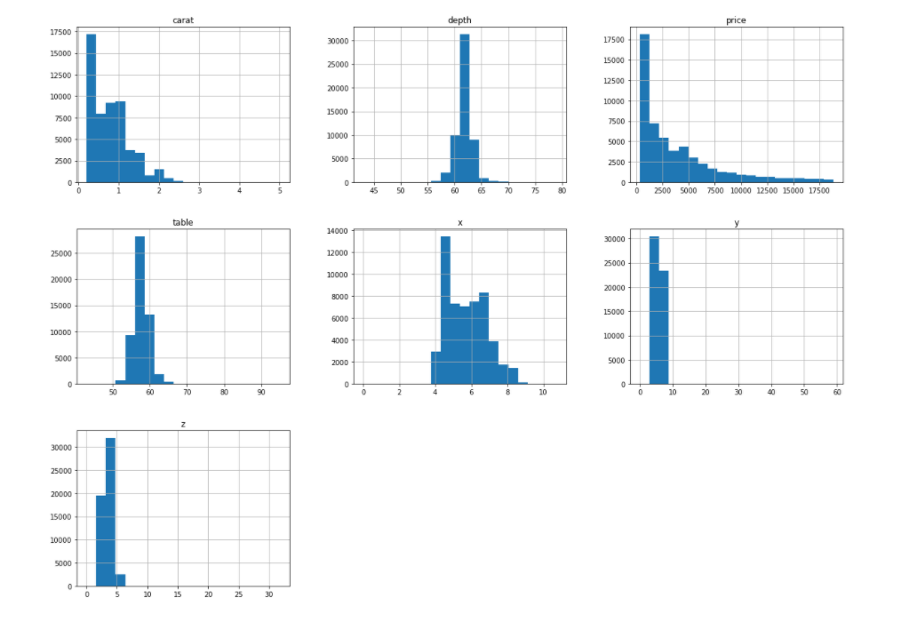
now let’s look at the data…..visually
-We notice that most of the numerical data do have spikes(outliers). So, we will cap them.
-Also, carat is skewed to the right. consequently, we will transform it.

Slide 8
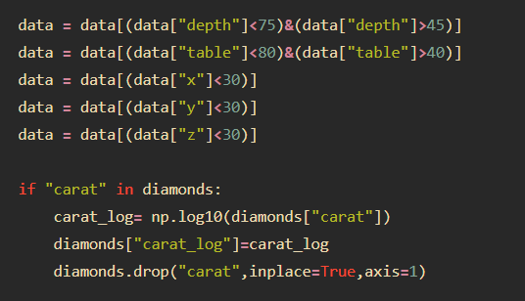
-In this code, we removed the the outliers from these attributes.
-We also transform the carat attribute using the log function
** We did these changes because the outliers and the skewness affect the model performance.

Slide 9
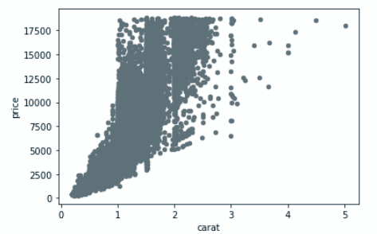
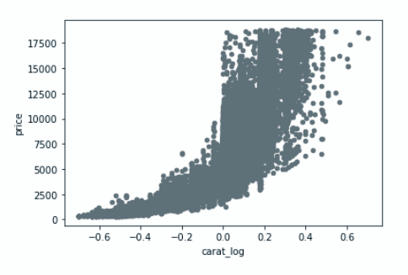
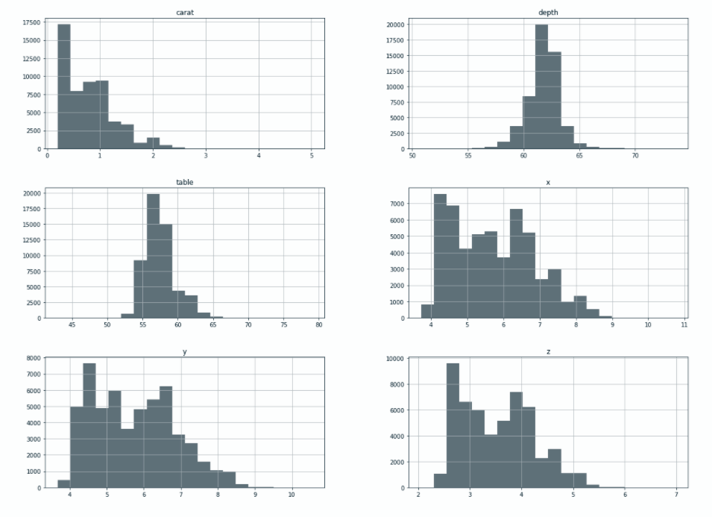
-And this is the changes of data cap and transformation.

Slide 10
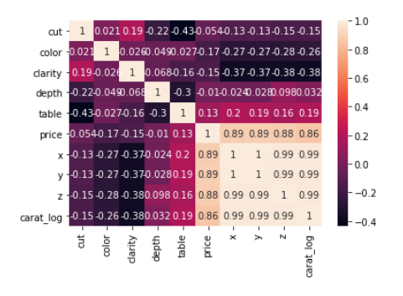
Data Correlations

Slide 11
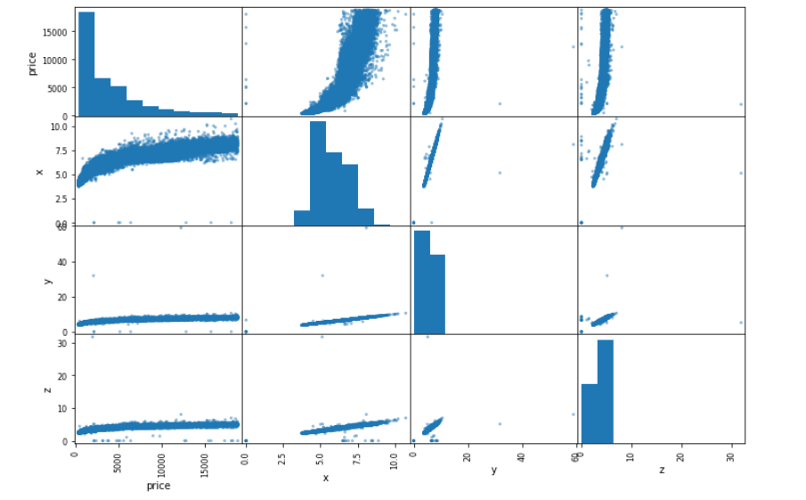
-We niticed that the correlation between the price and the other dimensions are similar.
-So, we presented the correlation between the them using Scutter_matrix.

Slide 12
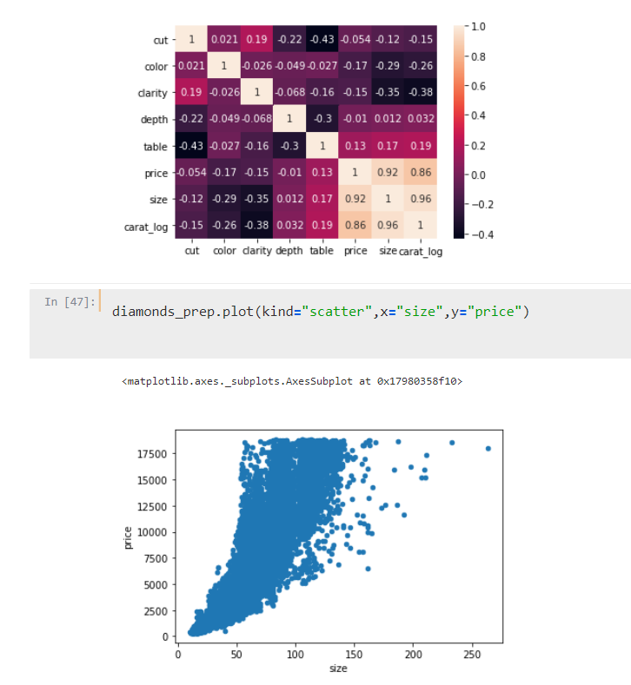
so we decided to try to combine the attributes (x, y, z) in “size” attribute - we assume that the diamond shape is near to pyramid shape, so we use the following formella size =⅓ * x*y*z
it won’t give us accurate size, but it will be good estimation or we think so.
but a good indicator is the correlation did get better as well as the scatter plot ….. so are crossing our fingers
** the size attribute have some outliers …. we will deal with them later

Slide 13
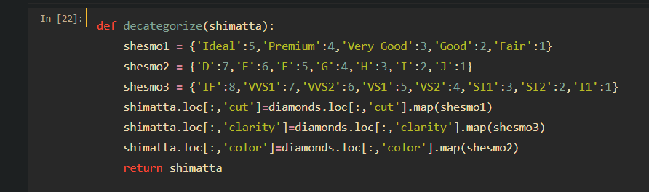
here we deal with the non-numerical data

Slide 14
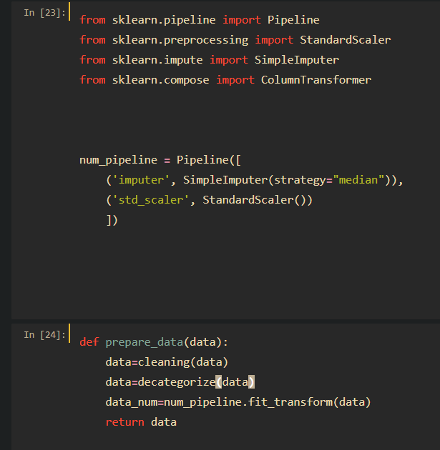
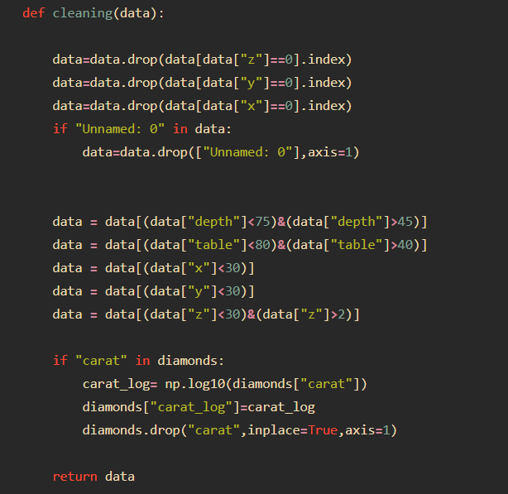
we have combined all the changes we have applied on the data in “prepare_data” function

Slide 15
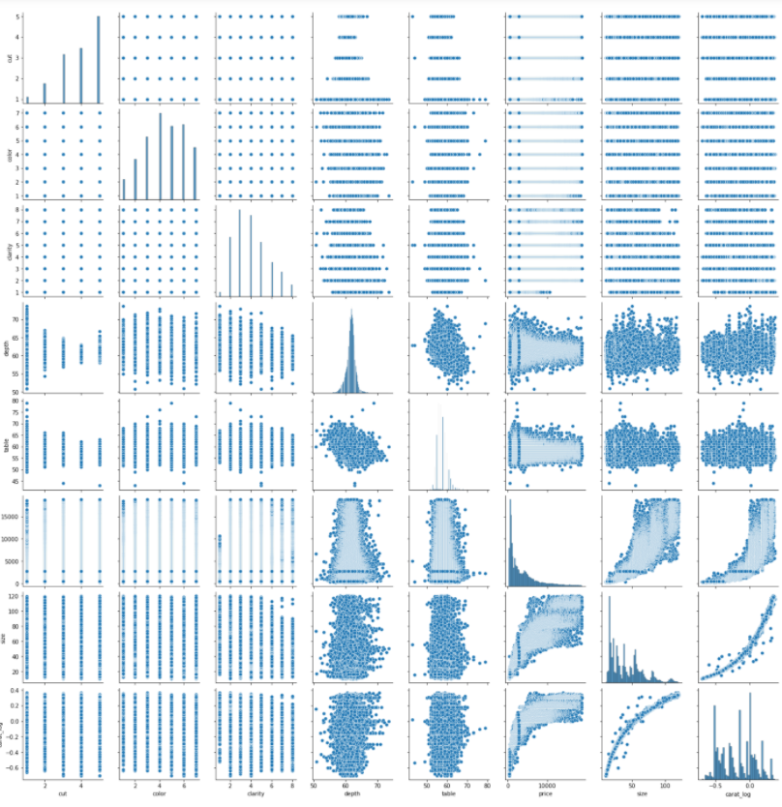
-This is the final form of data after the preparation.
-You will notice that x,y and z were replaced with another variable, we will get into it later.

Slide 16
now we have the data all set let’s start with real deal model training...

Slide 17
-before we start the real deal:
we will try to train the models on the
original data -after cleaning of corse-
and we will train it with the size attribute
we will start with the original
-with X, Y, Z attributes-

Slide 18
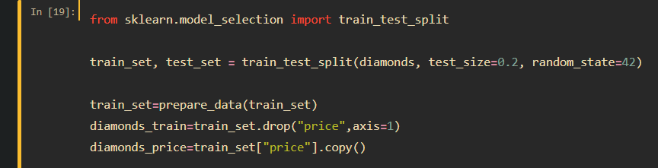
-First, we split the data to test set and train set

Slide 19
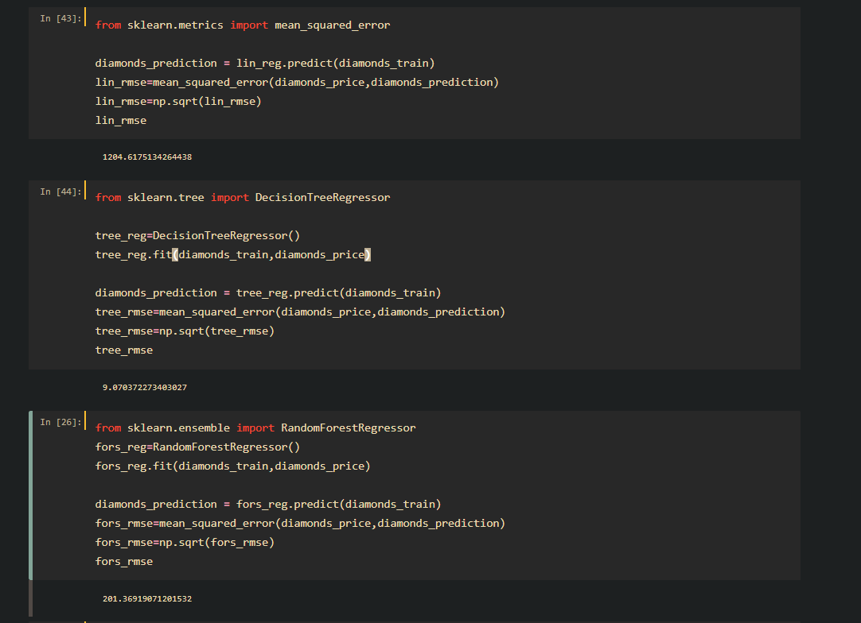
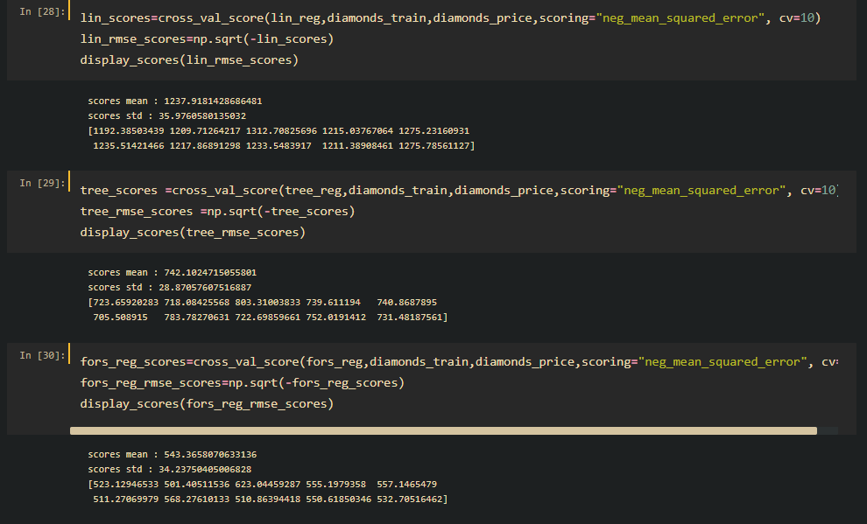
-We trained the models and calculated the RMSE for each of them, With and without the cross validation.

Slide 20
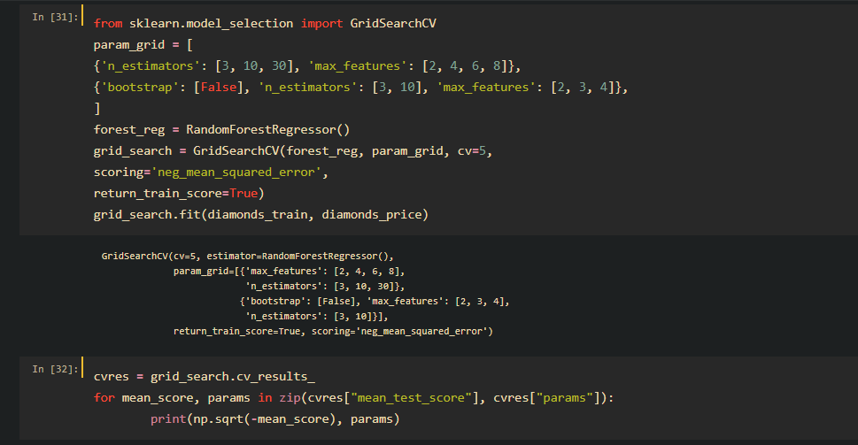
As we could see the random forest model gave us the best results, so we will continue the fine tuning stage with it

Slide 21
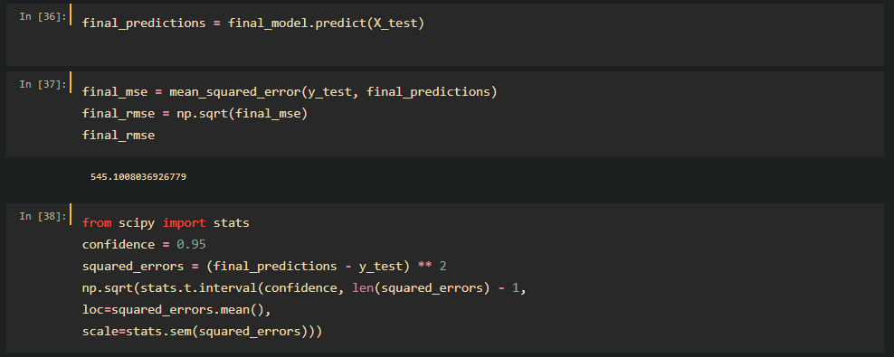
-here is the final model we got now we will try the other data form(which the dimensions are represented with “size”)

Slide 22
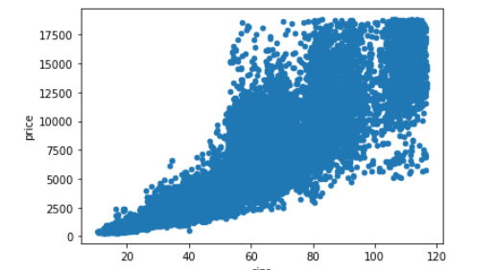
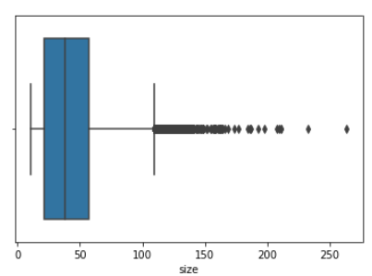
-before we begin we omit the outliers, and the data shape got better.
-The first image is the correlation between size and price after using the log function and removing the outliers.

Slide 23
-we did LinearRegression, DecisionTreeRegressor and RandomForestRegressor.
-The same steps we did in the last model, and we got the next results:

Slide 24
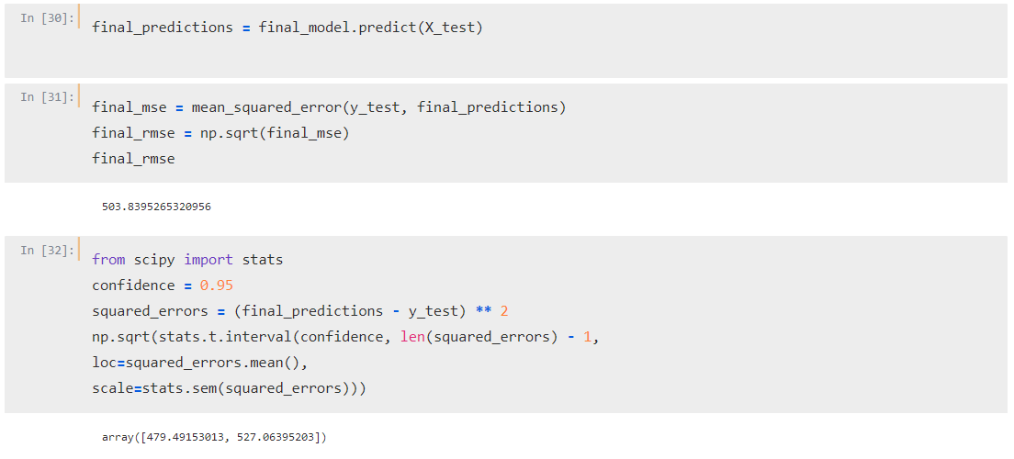
the results got better !
-The result of random forest on the data of x,y and z was 545.
-Whereas the result using size instead of them is better.

Slide 25
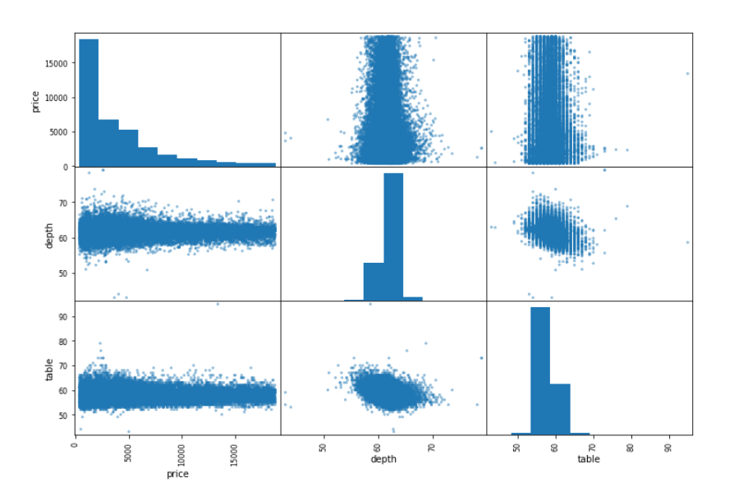
quick notes
we’ve looked at the depth attribute, both the correlation and the scatter plot are not very promising, the correlation for depth with price is -0.0075.
so we tried to deleted from the data set but the
results didn’t improve that much
according to that, we didn’t try to change the
table since it has higher correlation to the price

